Slide 1
Modeling Transformations
CSE 409
Md. Tanvir Al Amin*
Lecturer, Dept. of CSE, BUET
tanviralamin@gmail.com
*Special Thanks to Tanvir Parvez, Fredo Durand, James O Brien, Tomas Lozano-Perez, Jovan Popovic

Slide 2
Transformation Background
What is Transformation ?

Slide 3
What is a Transformation
Transformation:
  An operation that changes one configuration into another
For images, shapes, etc.
  A geometric transformation maps positions that define the object to other positions
  Linear transformation means the transformation is defined by a linear function... which is what matrices are good for.

Slide 4
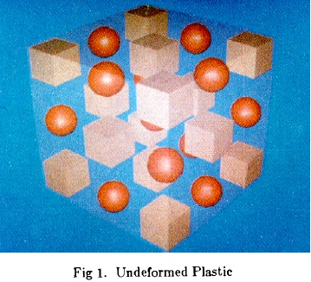
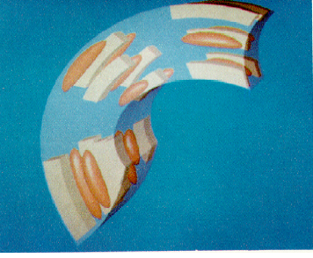

What is a Transformation?
A function that maps points x to points x':
  Applications: animation, deformation, viewing, projection, real-time shadows, …

Slide 5
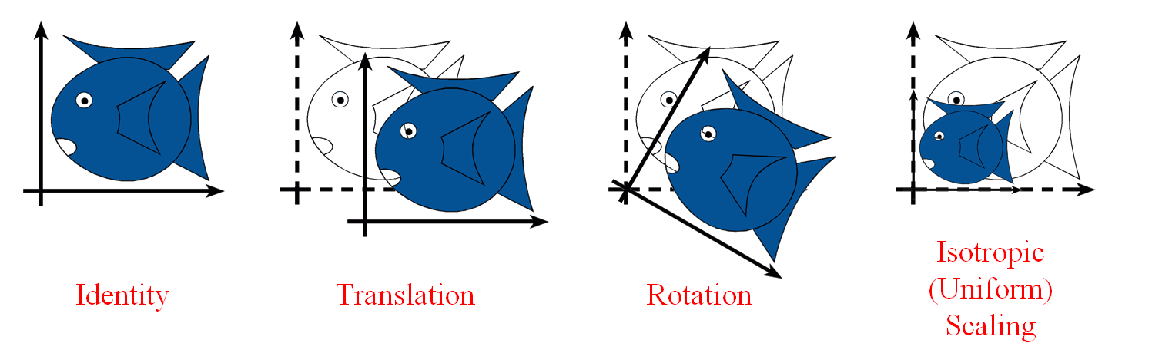
Simple Transformations
Can be combined
Are these operations invertible?
Yes, except scale = 0

Slide 6
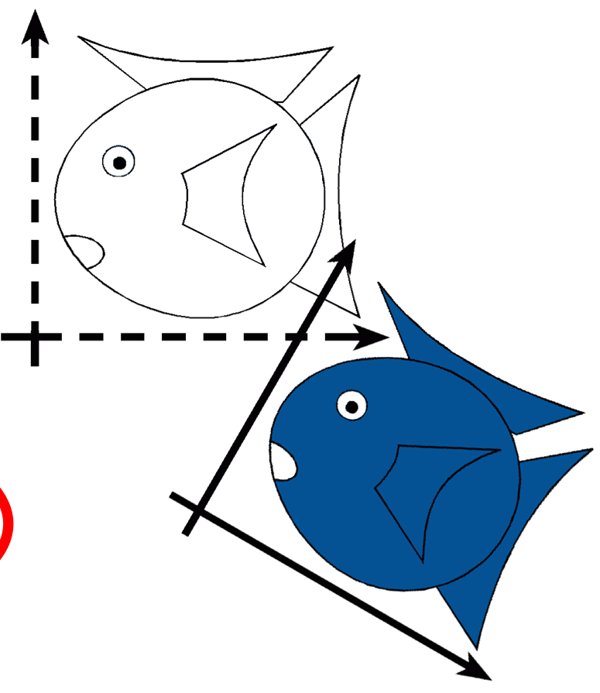
Rigid-Body / Euclidean Transforms
Preserves distances
Preserves angles
Rigid / Euclidean
Identity
Translation
Rotation

Slide 7
Similitudes / Similarity Transforms
Preserves angles
Similitudes
Rigid / Euclidean
Identity
Translation
Isotropic Scaling
Rotation

Slide 8
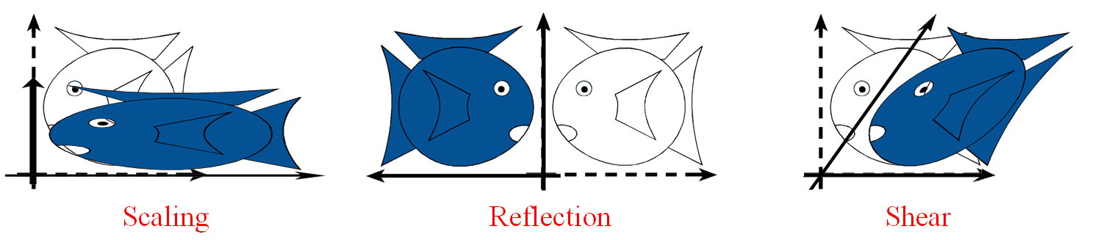
Linear Transformations
Similitudes
Linear
Rigid / Euclidean
Scaling
Identity
Translation
Isotropic Scaling
Reflection
Rotation
Shear

Slide 9
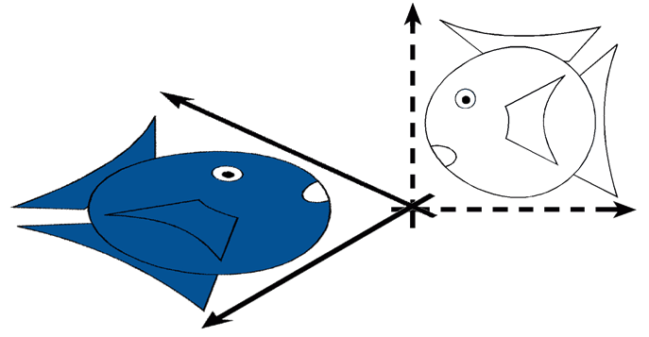
Linear Transformations
L(p + q) = L(p) + L(q)
L(ap) = a L(p)
Similitudes
Linear
Rigid / Euclidean
Scaling
Identity
Translation
Isotropic Scaling
Reflection
Rotation
Shear

Slide 10
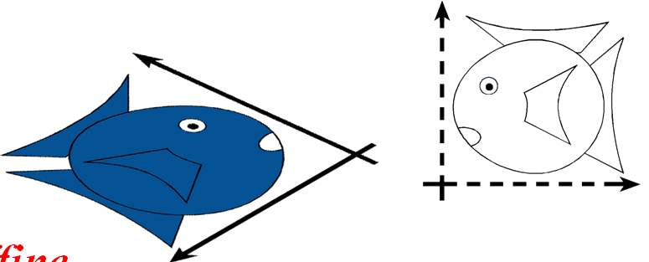
Affine Transformations
preserves
parallel lines
Affine
Similitudes
Linear
Rigid / Euclidean
Scaling
Identity
Translation
Isotropic Scaling
Reflection
Rotation
Shear

Slide 11
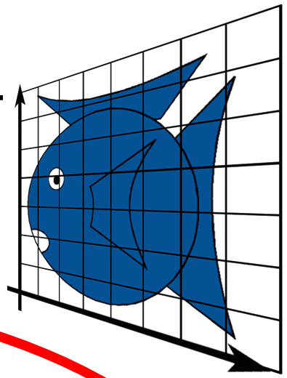
Projective Transformations
preserves lines
Projective
Affine
Similitudes
Linear
Rigid / Euclidean
Scaling
Identity
Translation
Isotropic Scaling
Reflection
Rotation
Shear
6.837 Fall 06 – Durand
Perspective

Slide 12
How are Transforms Represented?
x' = ax + by + c
y' = dx + ey + f
x'
y'
a b
d e
x
y
c
f
=
+
p' = M p + t

Slide 13
Translation in homogenous coordinates
x' = ax + by + c
y' = dx + ey + f
Cartesian formulation
Homogeneous formulation
x'
y‘
1
a b
d e
0 0
c
f
1
x
y
1
x'
y'
a b
d e
x
y
c
f
=
=
+
p' = M p + t
p' = M p

Slide 14
Homogeneous Co-ordinates
Translation, scaling and rotation are expressed (non-homogeneously) as:
  translation: P′ = P + T
  Scale: P′ = S · P
  Rotate: P′ = R · P
Composition is difficult to express, since translation not expressed as a matrix multiplication
Homogeneous coordinates allow all three to be expressed homogeneously, using multiplication by 3 × 3 matrices
W is 1 for affine transformations in graphics
Notes:
Onli linear of points is valid is an affine combination

Slide 15
Homogeneous Coordinates
Add an extra dimension
    in 2D, we use 3 x 3 matrices
    In 3D, we use 4 x 4 matrices
Each point has an extra value, w
x'
y'
z'
w'
a
e
i
m
b
f
j
n
c
g
k
o
d
h
l
p
x
y
z
w
=
p' = M p

Slide 16
Homogeneous Coordinates
Most of the time w = 1, and we can ignore it
If we multiply a homogeneous coordinate
by an affine matrix, w is unchanged
x'
y'
z'
1
a
e
i
0
b
f
j
0
c
g
k
0
d
h
l
1
x
y
z
1
=

Slide 17
Homogeneous Co-ordinates
P_{2d} is a projection of P_{h} onto the w = 1 plane
So an infinite number of points correspond to : they constitute the whole line (tx, ty, tw)
w
P_{h}(x,y,w)
w=1
P_{2d}(x,y,1)
y
x

Slide 18
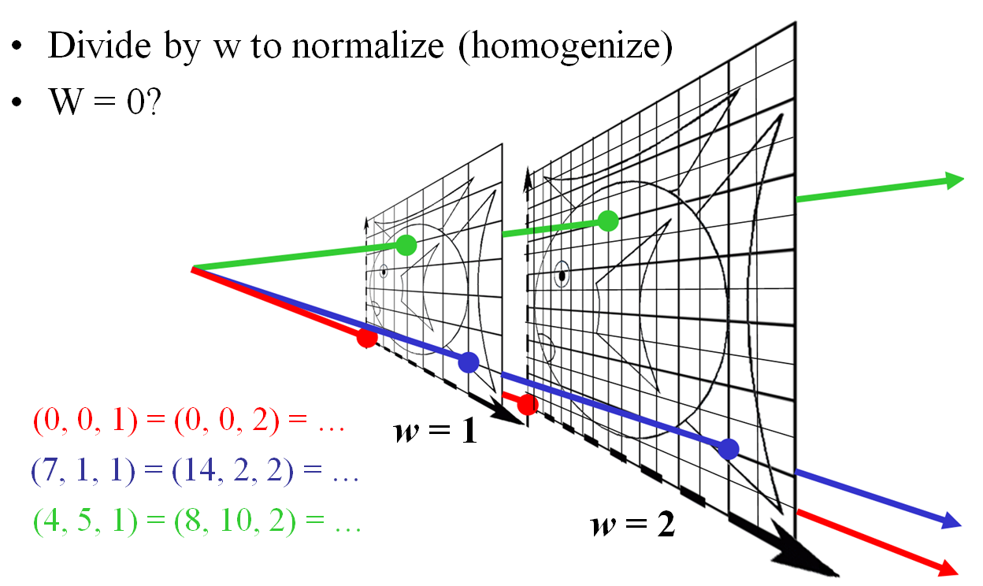
Homogeneous Visualization

Slide 19
Mechanics of Rigid Transformations
Translate
Rotate
Scale

Slide 20
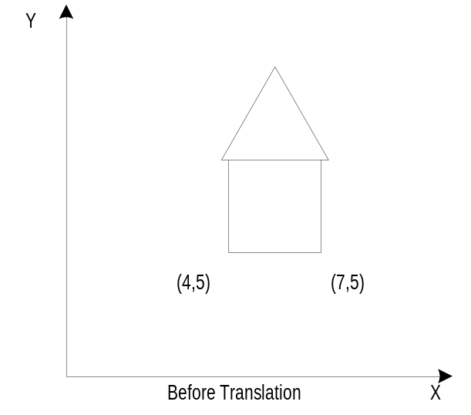
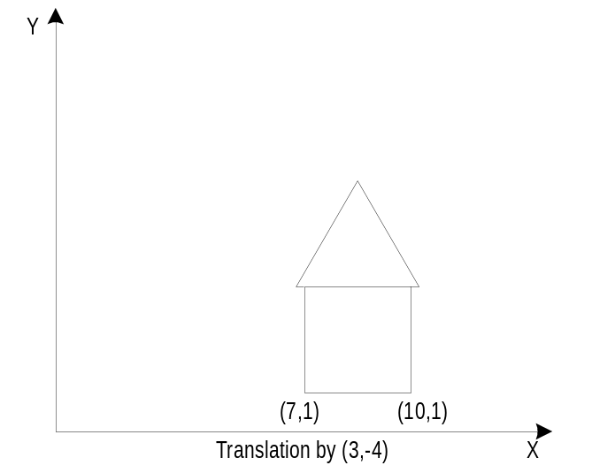
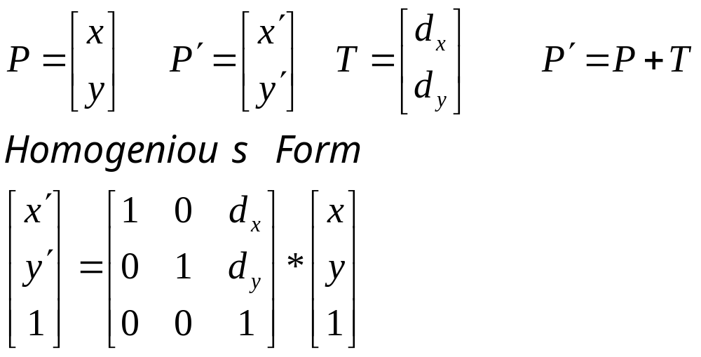
Translation – 2D
x’ = x + d_{x}
y’ = y + d_{y}

Slide 21
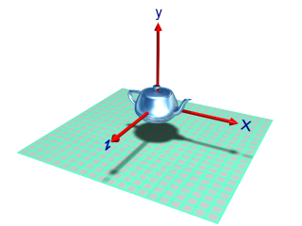
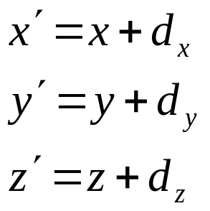
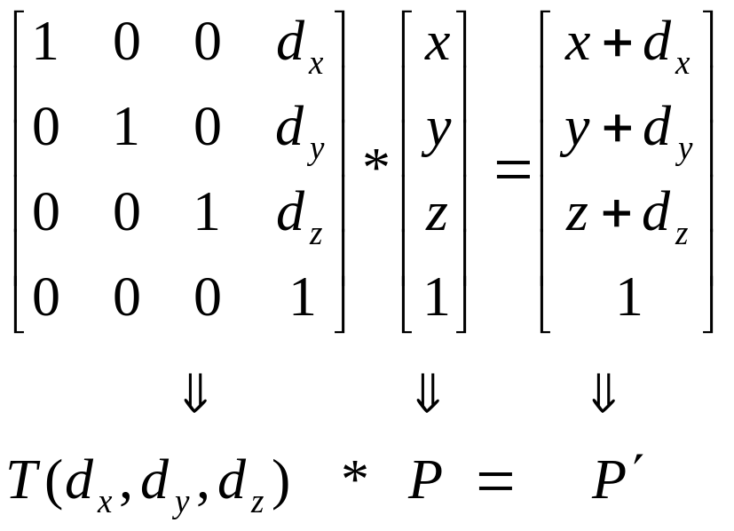
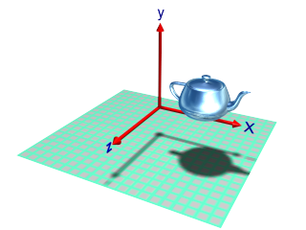
Translation – 3D

Slide 22
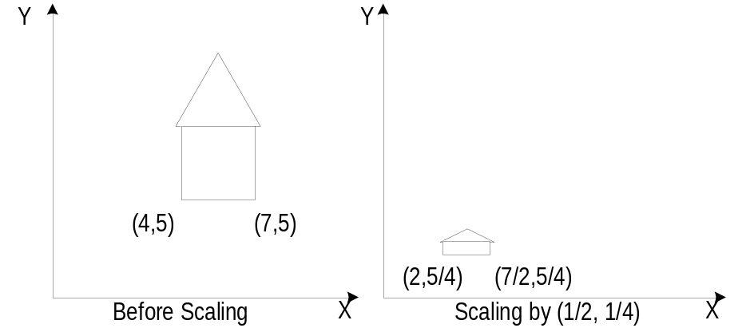
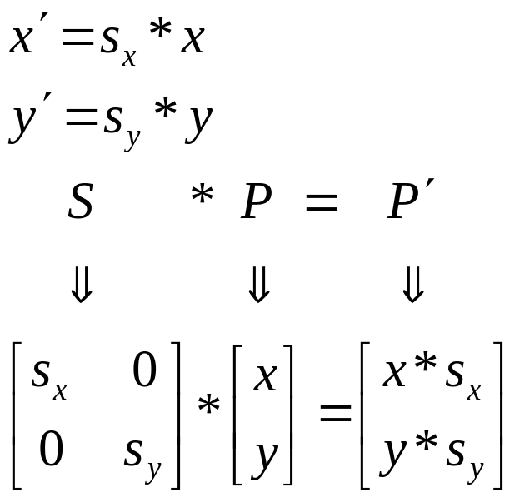
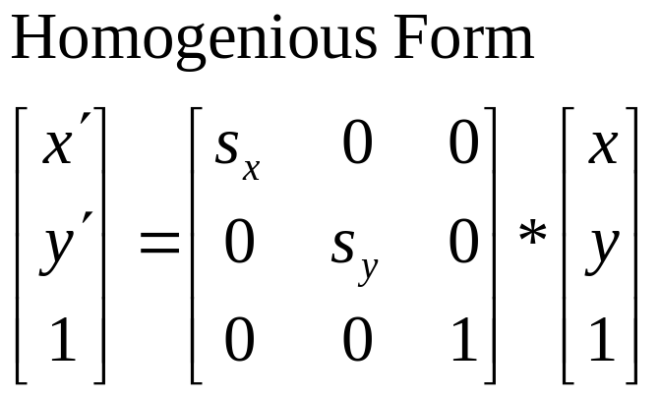
Scaling – 2D
Types of Scaling:
Differential ( s_{x} != s_{y} )
Uniform ( s_{x} = s_{y} )

Slide 23
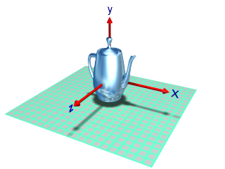
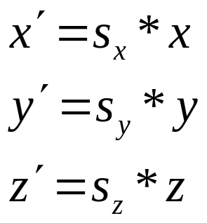
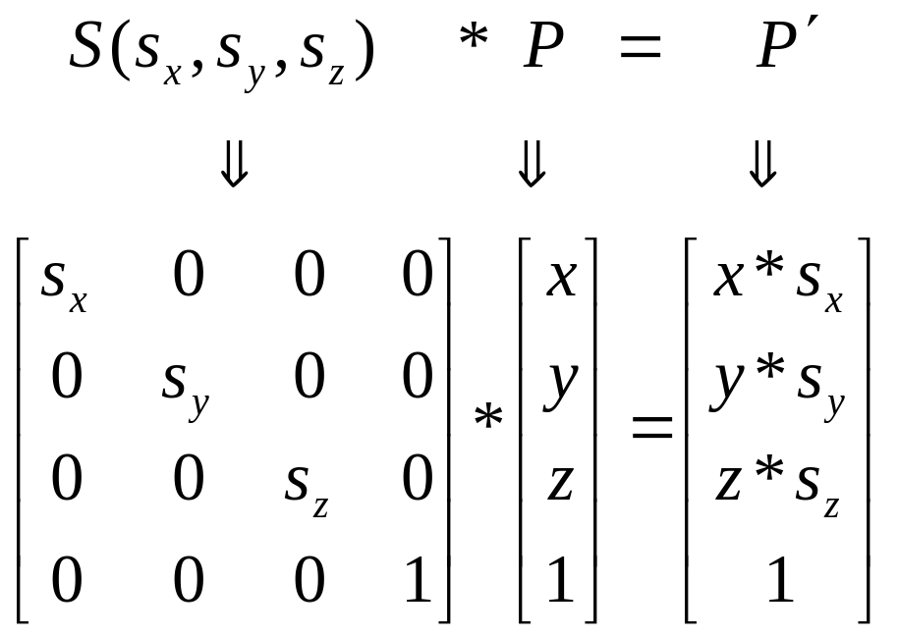
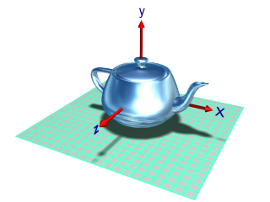
Scaling – 3D
Original
scale Y axis
scale all axes

Slide 24
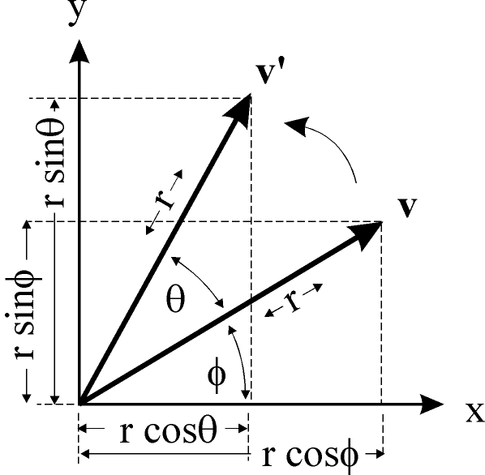
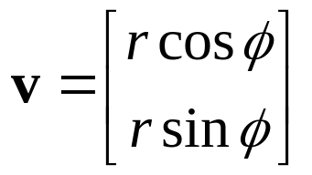
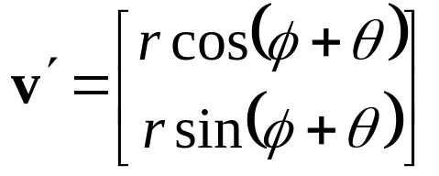
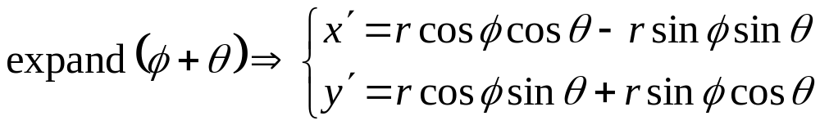
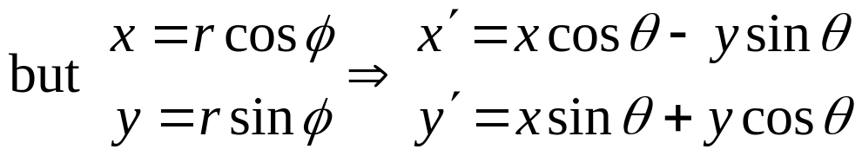
Rotation – 2D
rotated
original

Slide 25
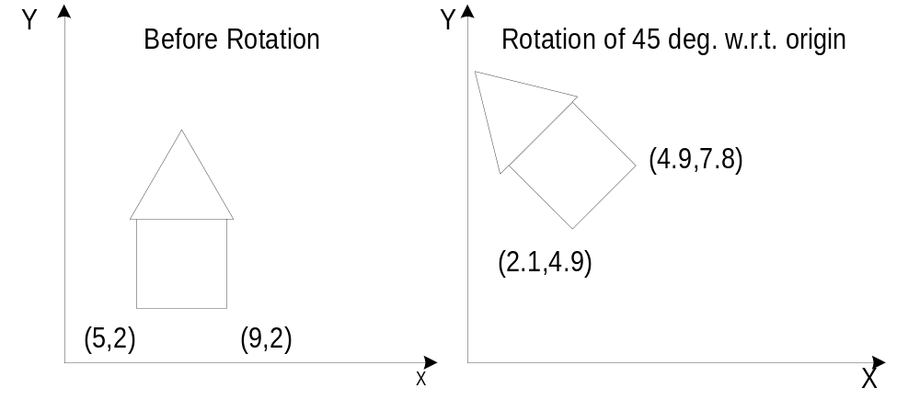
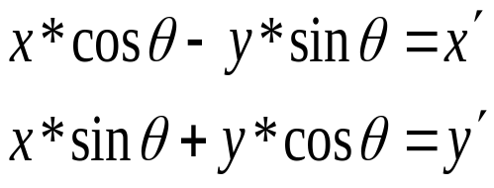
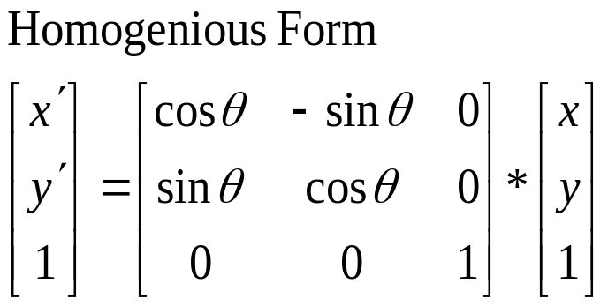
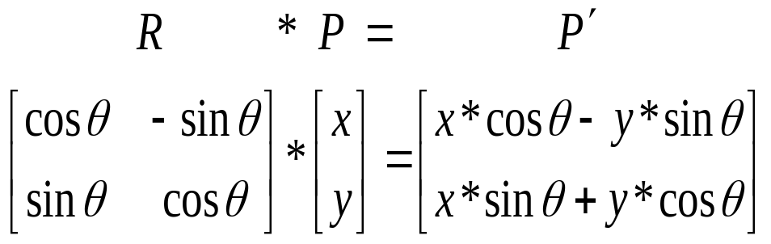
Rotation – 2D

Slide 26
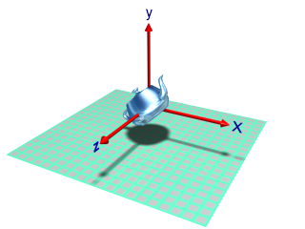
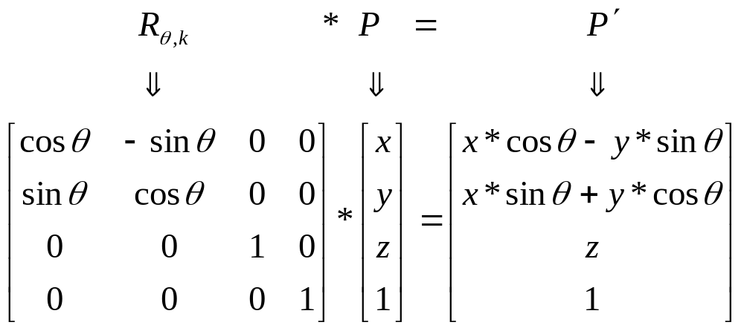
Rotation – 3D
For 3D-Rotation 2 parameters are needed
Angle of rotation
Axis of rotation
Rotation about z-axis:

Slide 27
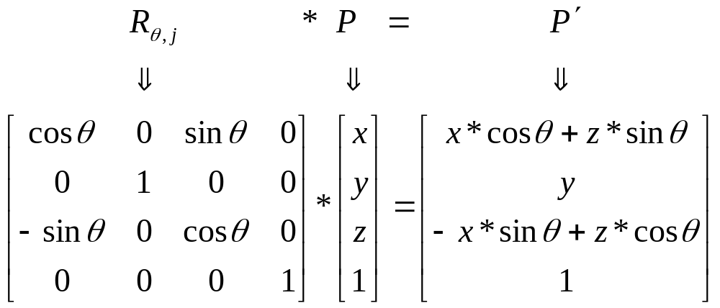
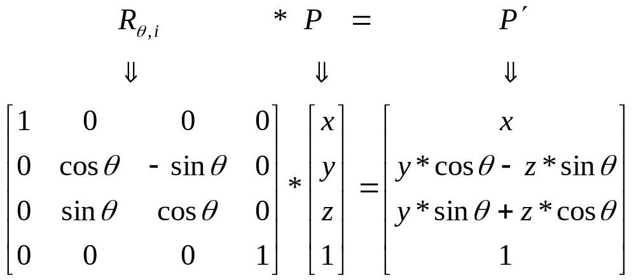
Rotation about Y-axis & X-axis
About y-axis
About x-axis

Slide 28
Rotation about Z axis
ZRotate(θ)
y
p'
About z axis
θ
p
x
z
x'
y'
z'
1
cos θ
sin θ
0
0
-sin θ
cos θ
0
0
0
0
1
0
0
0
0
1
x
y
z
1
=

Slide 29
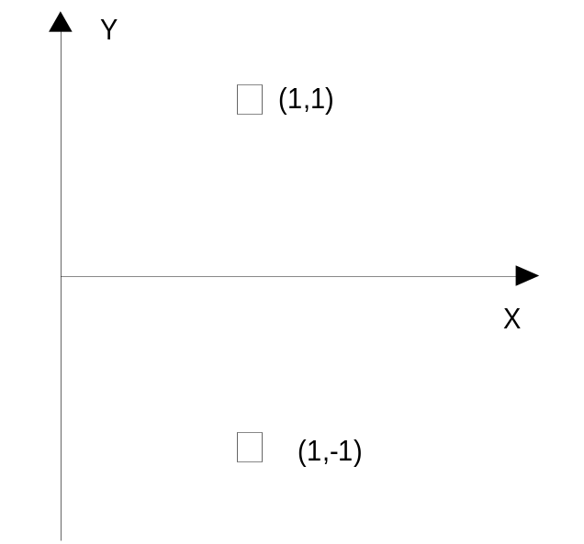
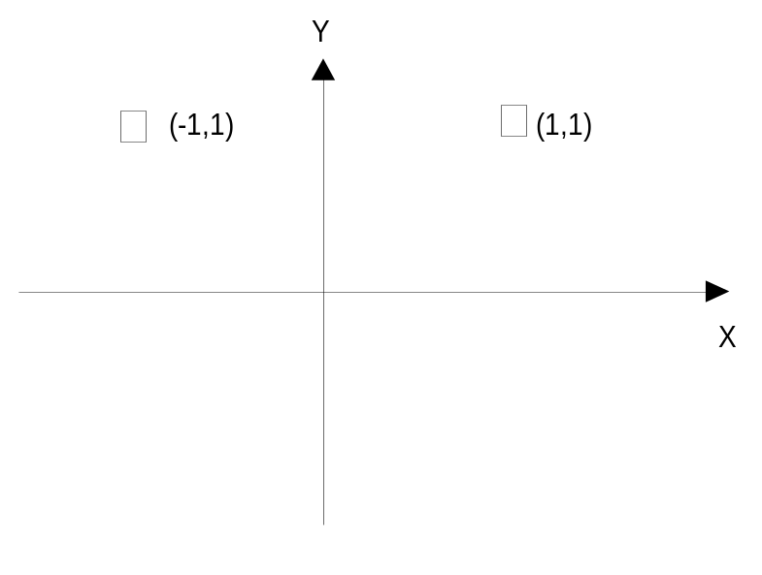
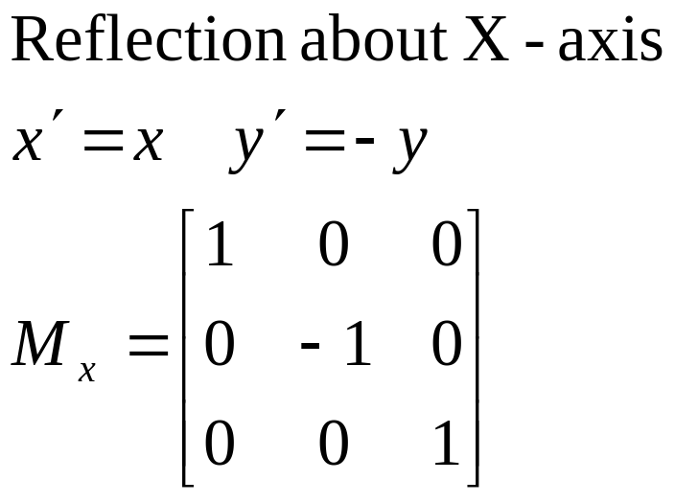
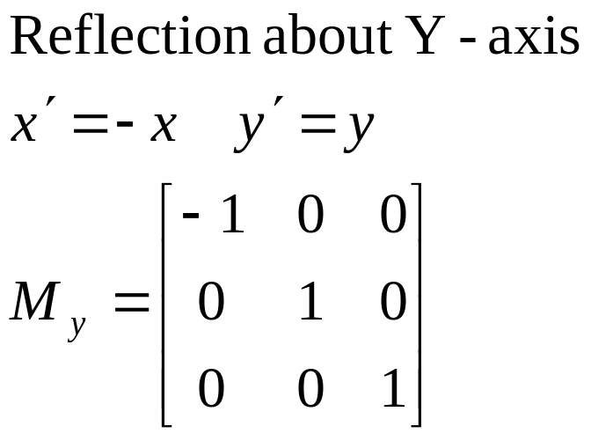
Mirror Reflection

Slide 30
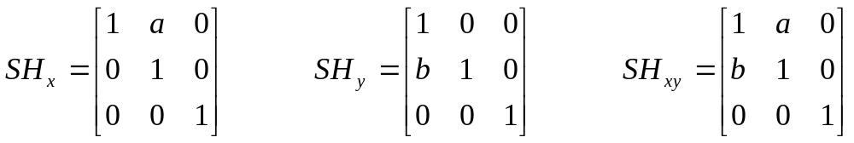
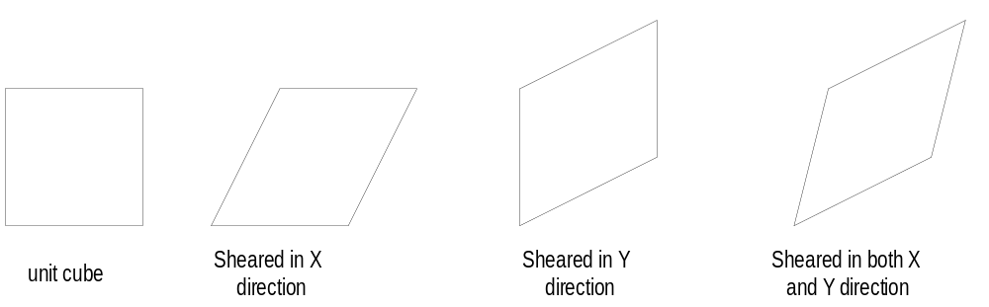
Shearing Transformation

Slide 31
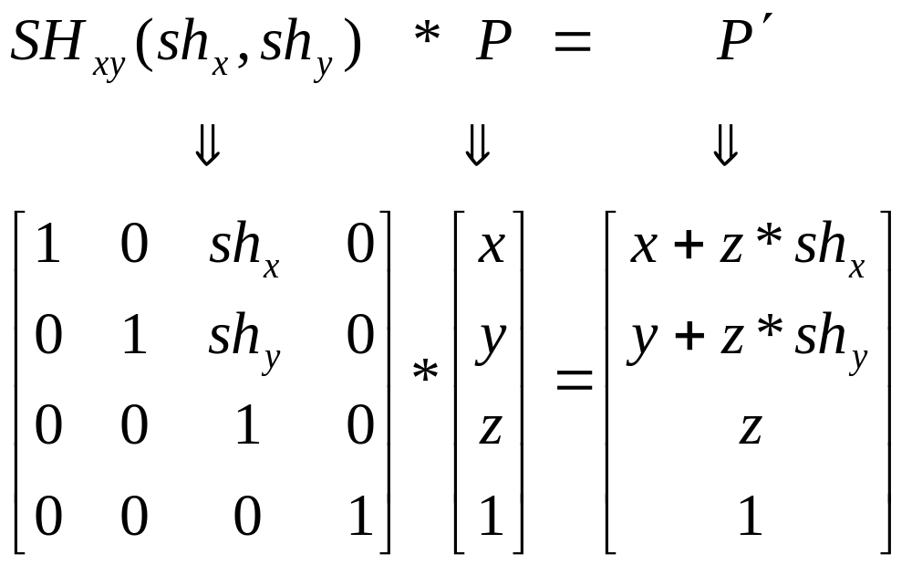
Shear along Z-axis
y
x
z

Slide 32

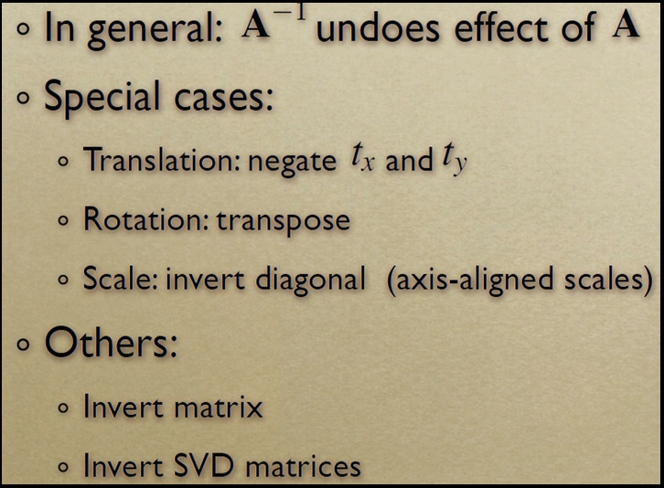
Inverse Transforms

Slide 33
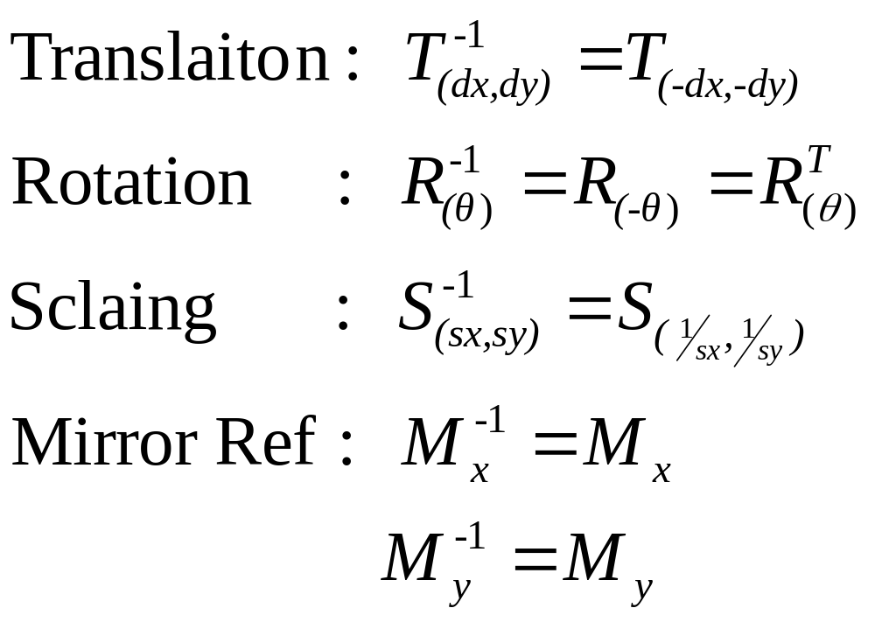
Inverse Transformations

Slide 34
Composing Transformations

Slide 35
How are transforms combined?
Scale then Translate
(5,3)
Scale(2,2)
(2,2)
Translate(3,1)
(1,1)
(3,1)
(0,0)
(0,0)
Use matrix multiplication: p' = T ( S p ) = TS p
0
0
1
0
2
0
2
1
0
0
1
0
0
1
0
0
1
3
1
2
0
0
0
2
0
3
1
TS =
=
Caution: matrix multiplication is NOT commutative!

Slide 36
Non-commutative Composition
Scale then Translate: p' = T ( S p ) = TS p
(5,3)
Scale(2,2)
(2,2)
Translate(3,1)
(1,1)
(3,1)
(0,0)
(0,0)
Translate then Scale: p' = S ( T p ) = ST p
(8,4)
Translate(3,1)
(4,2)
Scale(2,2)
(6,2)
(1,1)
(3,1)
(0,0)

Slide 37
Non-commutative Composition
Scale then Translate: p' = T ( S p ) = TS p
1
0
0
0
1
0
3
1
1
2
0
0
0
2
0
0
0
1
2
0
0
0
2
0
3
1
1
TS =
=
Translate then Scale: p' = S ( T p ) = ST p
0
0
1
2
0
0
2
0
0
1
0
0
1
3
1
2
0
0
2
6
2
0
0
1
0
0
1
ST =
=

Slide 38
Combining Translations, Rotations
Order matters!! TR is not the same as RT (demo)
General form for rigid body transforms
We show rotation first, then translation (commonly used to position objects) on next slide. Slide after that works it out the other way

Slide 39
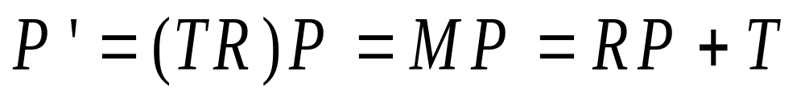
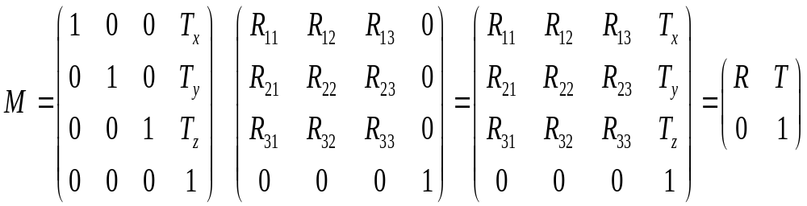
Rotate then Translate

Slide 40
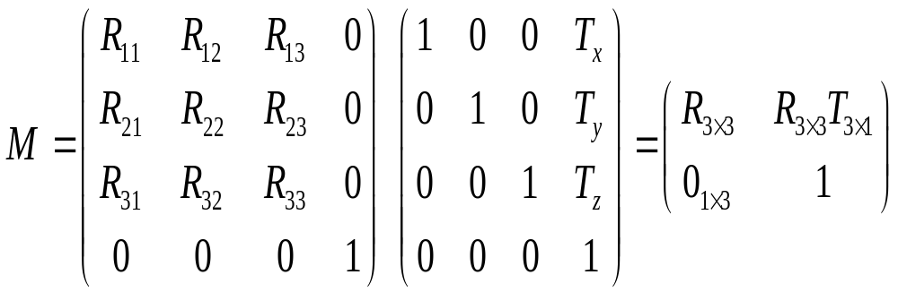
Translate then Rotate

Slide 41
Associativity of Matrix Multiplication
Create new affine transformations by multiplying sequences of the above basic transformations.
q = CBAp
q = ( (CB) A) p = (C (B A))p = C (B (Ap) ) etc.
matrix multiplication is associative.
To transform just a point, better to do q = C(B(Ap))
But to transform many points, best to do
M = CBA
then do q = Mp for any point p to be rendered.
For geometric pipeline transformation, define M and set it up with the model-view matrix and apply it to any vertex subsequently defined to its setting.

Slide 42
Example Composite Transforms
2D Case

Slide 43
Rotation of θ about P(h,k): R_{θ,P}
Step 1: Translate P(h,k) to origin
Step 2: Rotate θ w.r.t to origin
Q³(x’+h, y’ +k)
Step 3: Translate (0,0) to P(h,k0)
P³(h,k)
R_{θ,P}=
T(h ,k) *
R_{θ}*
T(-h ,-k)
Q(x,y)
Q¹(x’,y’)
Q²(x’,y’)
P(h,k)
P¹ (0,0)
P² (0,0)

Slide 44
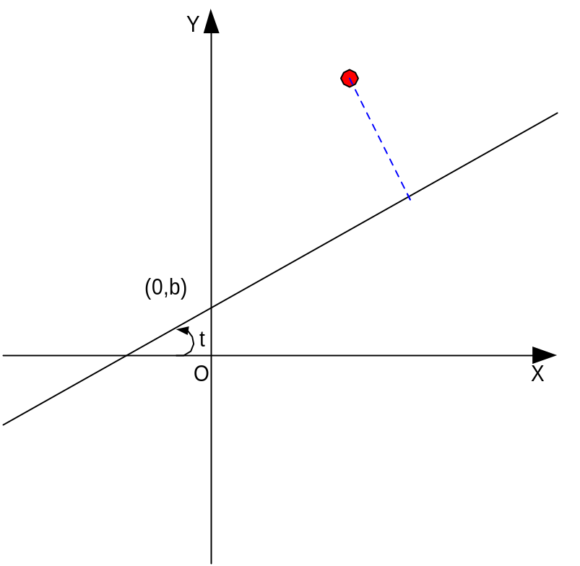
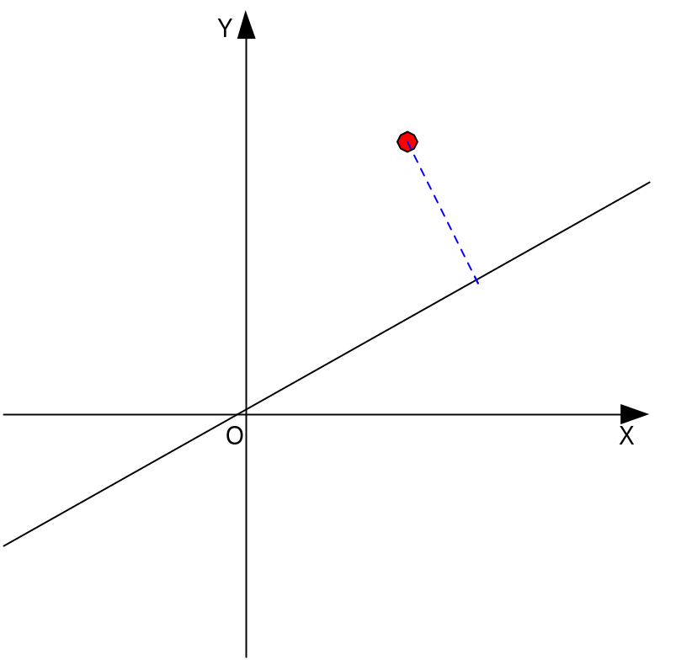




Reflection about line L, M_{L}
Step 1: Translate (0,b) to origin
Step 2: Rotate -θ degrees
Step 3: Mirror reflect about X-axis
Step 4: Rotate θ degrees
Step 5: Translate origin to (0,b)
M_{L} =
T(0 ,b) *
R(θ) *
M _{x}*
R(-θ) *
T(0 ,-b)

Slide 45
Rotation
How to rotate around (kx, ky, kz), a unit
vector on an arbitrary axis …
Example : Rotate 30 degree around vector 2i+1j+3k
  Can it be found from some rotation around x axis, then some rotation around y axis, then z axis ?

Slide 46
Finding the Rotation Matrix
Our previous method
Step 1,2 Perform two rotations so that a becomes aligned with the z-axis (two rotations are necessary)
Step 3 Do the required θ rotation around z-axis
Step 4,5 Undo the alignment rotations to restore a to its original direction
Alignment
Rotation
Trace Back
Trivial but you should be
careful when doing in hands

Slide 47
Step 1,2
We now study a composite transformation
A_{V,N} = aligning a vector V with a vector N
To find the rotation matrix, we need to find A_{v,k}

Slide 48




A_{V} : aligning vector V with k
A_{v} =
R_{θ,i}

Slide 49



A_{V} : aligning vector V with k
A_{v} =
R_{-ϕ,j} *
R_{θ,i}

Slide 50

A_{V} : aligning vector V with k
A_{V}⁻¹ = A_{V}^{T}
A_{V,N} = A_{N}⁻¹ * A_{V}

Slide 51

Finding the rotation matrix
Now we have done step 1,2 : A_{V}
For step 3, we have to rotate theta angle around z axis
Then take the inverse of step 1,2,
  A_{V}⁻¹ = A_{V}^{T}
There are actually 5 rotations here. None of which are Euler angles α or β or γ

Slide 52



Axis Angle Notation
Rodrigues Formula

Slide 53

The Geometry of a Rotation

Slide 54

The Geometry of a Rotation

Slide 55

The Geometry of Rotation

Slide 56




The Geometry of Rotation
So we find, the rotation vector is :
This is a vector equation, which is good
But, we need a matrix form also, to work easily.
Vector Form
Rodrigues
Formula
Matrix Form

Slide 57


Rodrigues Formula
Vector and Matrix forms
How we find these equivalent matrix and vector forms ?
Check next slide

Slide 58

Vector and Matrix algebra

Slide 59

Cross product in Matrix Form

Slide 60



Finding rotations from a rotation matrix
Given, R is a pure rotation matrix
Find axis of rotation K(k_{x},k_{y},k_{z})
and angle theta from R
Recall rodrigues formula, it gives R
Check that :
Trace(R ) = Sum of diagonal elements of the 3x3 rotation matrix

Slide 61


Finding rotations from a rotation matrix
Check that :

Slide 62
Properties of rotation matrix
The columns of rotation matrix are unit vectors perpendicular to each other
The column vectors indicate where the unit vectors along the principal axes are transformed
The rows of rotation matrix are unit vectors perpendicular to each other
The row vectors indicate the vectors that are transformed into the unit vectors along the principal axes
The inverse of rotation matrix is its transpose

Slide 63
References
Chapter 4 and Chapter 6, Schaum's Outline of Computer Graphics (2nd Edition) by Zhigang Xiang, Roy A. Plastock
Chapter 5, Computer Graphics: Principles and Practice in C (2nd Edition) by James D. Foley, Andries van Dam, Steven K. Feiner, John F. Hughes
Chapter 6, Fundamentals of Computer Graphics, by Peter Shirley

